Slide 1
Summer Internship Project
S.Abishek
AP19110010087

Slide 2

PROJECT TITLE :DETECTION OF PARKINSON’s DISEASE USING AIML MODELS

Slide 3
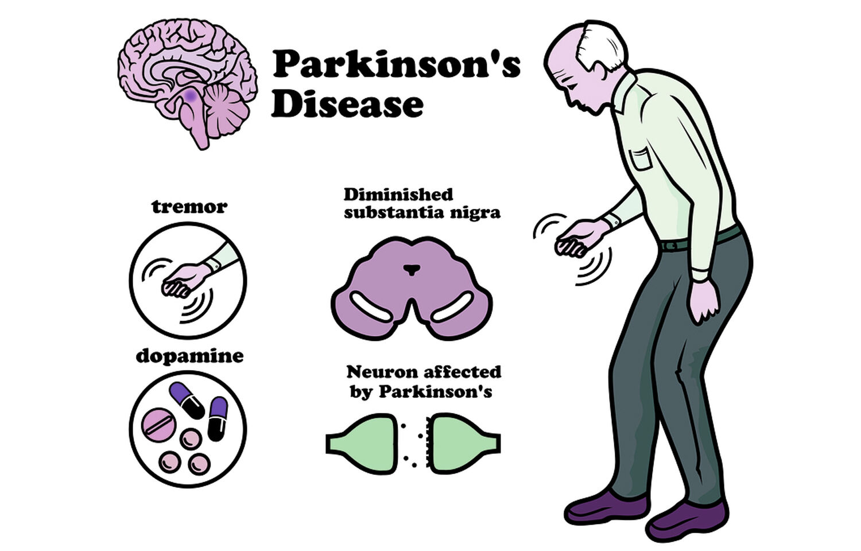
What is Parkinson’s disease?
Parkinson's disease is a progressive nervous system disorder that affects movement.
Symptoms start gradually, sometimes starting with a barely noticeable tremor in just one hand.
Nerve cell damage in the brain causes dopamine levels to drop, leading to the symptoms of Parkinson's.
It has 5 stages to it and affects more than 1 million individuals every year in India.
Commonly observed in Men of age 60 or above.
Treatment can help, but this condition can't be cured.

Slide 4
Dataset for the Project:
Dataset link - https://archive.ics.uci.edu/ml/datasets/parkinsons
Objective:
To build a machine learning model that accurately detects the presence of Parkinson’s disease in an individual. This disease has no known cure. This project deals with a real-world medical issue that can help doctors determine if a person has Parkinson’s and how the disease is likely to progress.

Slide 5
Modules:
Numpy
Pandas
Matlplotlib
Seaborn
Scikit- Learn
Software Used:
Anaconda Navigator
Jupyter Notebook

Slide 6
Attribute Information:
Name - ASCII subject name and recording number
MDVP:Fo(Hz) - Average vocal fundamental frequency
MDVP:Fhi(Hz) - Maximum vocal fundamental frequency
MDVP:Flo(Hz) - Minimum vocal fundamental frequency
MDVP:Jitter(%),MDVP:Jitter(Abs),MDVP:RAP,MDVP:PPQ,Jitter:DDP - Several measures of variation in fundamental frequency
MDVP:Shimmer,MDVP:Shimmer(dB),Shimmer:APQ3,Shimmer:APQ5,MDVP:APQ,Shimmer:DDA - Several measures of variation in amplitude
NHR,HNR - Two measures of ratio of noise to tonal components in the voice
status - Health status of the subject (one) - Parkinson's, (zero) - healthy
RPDE,D2 - Two nonlinear dynamical complexity measures
DFA - Signal fractal scaling exponent
spread1,spread2,PPE - Three nonlinear measures of fundamental frequency variation
Dataset Information:
This dataset is composed of a range of biomedical voice measurements from 31 people, 23 with Parkinson's disease (PD). Each column in the table is a particular voice measure, and each row corresponds to one of 195 voice recordings from these individuals ("name" column). The main aim of the data is to discriminate healthy people from those with PD, according to the "status" column which is set to 0 for healthy and 1 for PD.

Slide 7
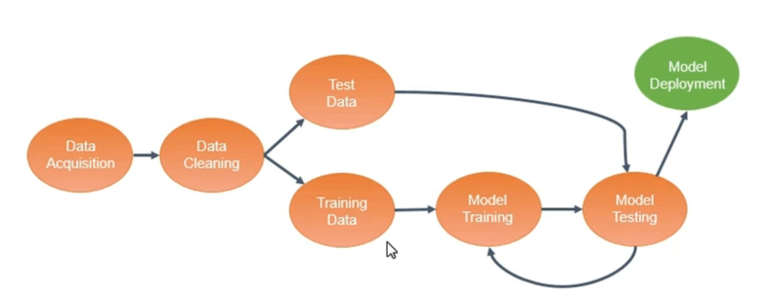
BLOCK DIAGRAM:

Slide 8
Data collection
Reading data set
1
Checking for missing values in the data
2
Finding columns and shape of the dataset
3

Slide 9
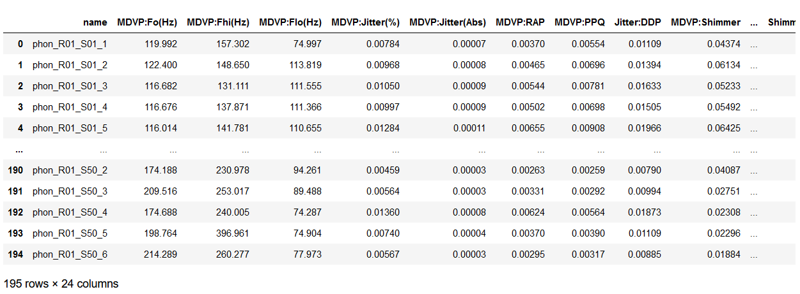
Dataset

Slide 10

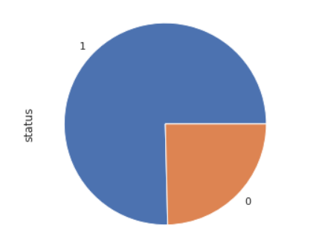
Explanatory data Analysis
EDA is a practice to understand the data first and try to gather as many insights as possible from it.
Finding Statistical Measures such as count, mean, standard deviation, minimum and maximum values, and the quantiles of the data etc.
Finding the Target Variable – The target variable is Status
If a Person has status value of 0 then he/she is healthy, If a Person has status value of 1 then they are affected with Parkinson’s Disease.
Finding distribution of the status of people in the dataset
147(Parkinson’s positive)
48(Healthy)
Plot for the target count

Slide 11
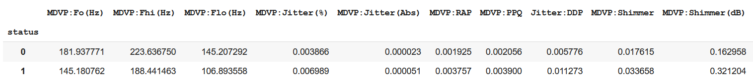
Finding mean for the Status column
From grouping we can find the major difference in attribute values
We also plot a heatmap to find the correlation between the independent and dependent variables.

Slide 12
Data Pre-processing and Standardization
Handling Categorical Values
Separating independent and target variable
Dropping the columns which are not required and Creating X and Y datasets
X is the data frame without name, status and Y is the Status Column
StandardScaler()is used to standardize the range of independent variables or features of the data
The range of the values are scaled from 1 to -1
Standard scaler function is used by importing sklearn
Creating a Numpy array by standardizing the dataset X

Slide 13
Splitting the dataset
Split the Feature set (X) and Target set (y) into training set (X_train, y_train) and testing set (X_test,y_test)
train_test_split function is used for splitting the data
The training data is 80% and Testing data is 20%
Finding Shapes of the datasets
Converting those values into NumPy arrays

Slide 14
There are 5 steps in model training
1. Importing the model
2. Training or Fitting the model
3. Predicting the model
4. Finding its Accuracy
5. Visualizing the Test set
Model Training

Slide 15
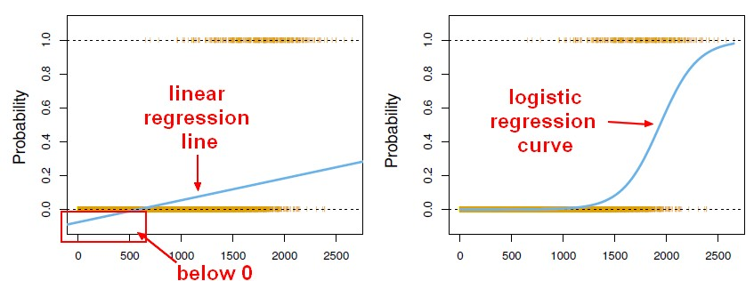
Linear Regression:
Linear Regression is an approach to the model the relationship between variables by fitting a linear equation to observed data
It predicts a dependent variable based on the values of the independent variables.
It is used for continuous data, but it is used here (classification problem) just for testing purposes.
Simple Linear Regression model to find out the best fitting line for representing the relationship between these two variables.
This is not the best model and not usually in practice.
Mathematical Equation:
y= a₀+a₁x+ ε
from sklearn.linear_model import LinearRegression

Slide 16

Logistic Regression
Logistic regression predicts the output of a categorical dependent variable. Therefore, the outcome must be a categorical or discrete value.
It can be either Yes or No, 0 or 1, true or False, etc. but instead of giving the exact value as 0 and 1, it gives the probabilistic values which lie between 0 and 1.
Logistic regression is used for solving the classification problems.
Mathematical function
Logistic Regression mode takes less training time in model training and gives probabilities between 0 and 1 using continuous discrete sets
from sklearn.linear_model import LogisticRegression

Slide 17
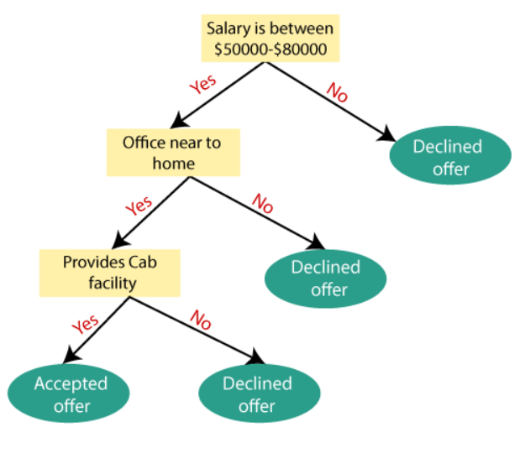
Decision Tree:
Decision Tree is a Supervised learning technique mostly it is preferred for solving Classification problems.
It is a tree-structured classifier, where internal nodes represent the features of a dataset, branches represent the decision rules, and each leaf node represents the outcome.
A decision tree simply asks a question and based on the answer (Yes/No), it further split the tree into subtrees.
Advantage: Simple to understand
Disadvantage: Contains lots of layers, which makes it complex.
It has both vertical and horizontal lines that are splitting the dataset.
It is a graphical representation for getting all the possible solutions to a problem/decision based on given conditions.
from sklearn import tree

Slide 18
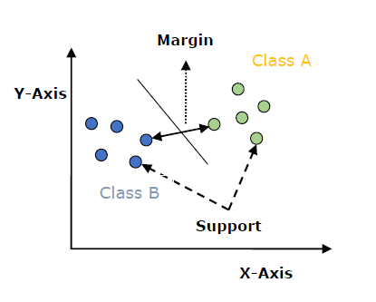
Support Vector Machine:
The goal of the SVM algorithm is to create the best line or decision boundary that can segregate n-dimensional space into classes so that we can easily put the new data point in the correct category in the future.
This best decision boundary is called a hyperplane.
It chooses the extreme points/vectors that help in creating the hyperplane.
These extreme cases are called as support vectors, and hence algorithm is termed as Support Vector Machine.
The distance between the vectors and the hyperplane is called as margin. And the goal of SVM is to maximize this margin.
Advantage: More effective in High dimensions
Disadvantage: It is not suitable for large data sets
We have used kernel='linear', as here we are creating SVM for linearly separable data and specifying a parameter increases its performance.
from sklearn import tree

Slide 19
Random Forest model
Random Forest is a classifier that contains several decision trees on various subsets of the given dataset and takes the average to improve the predictive accuracy of that dataset.
It involves bagging and ensemble learning.
Instead of relying on one decision tree, the random forest takes the prediction from each tree and based on the majority votes of predictions, and it predicts the final output.
Great number of trees the higher the accuracy and prevents overfitting.
XG Boost model
It is a perfect combination of software and hardware optimization techniques to yield superior results using fewer computing resources in the shortest amount of time.
XGBoost stands for eXtreme Gradient Boosting and is an implementation of Gradient Boosted decision trees.
It is based on the concept of ensemble learning offers a systematic solution to combine the predictive power of multiple learners & the resultant is a single model which gives the output from several models.
Weights are assigned to all the independent variables which are then fed into the decision tree which predicts results. Weights play an important role in XGBoost.

Slide 20
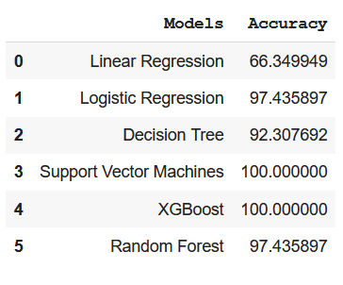
Accuracy for all the applied classifiers

Slide 21
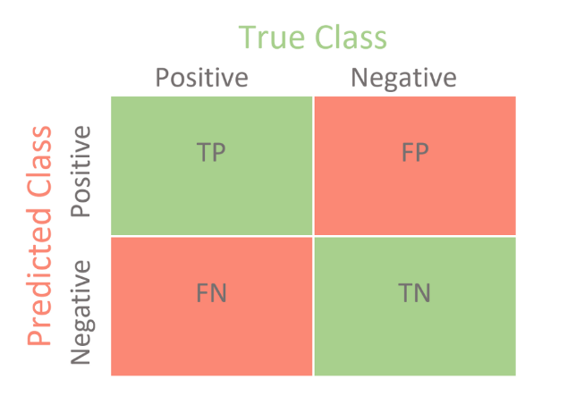
Confusion Matrices
The confusion matrix is a matrix used to determine the performance of the classification models for a given set of test data. It can only be determined if the true values for test data are known.
Evaluation metrics are
1.Precision
2.Accuracy
3.Recall
4.F1-score

Slide 22
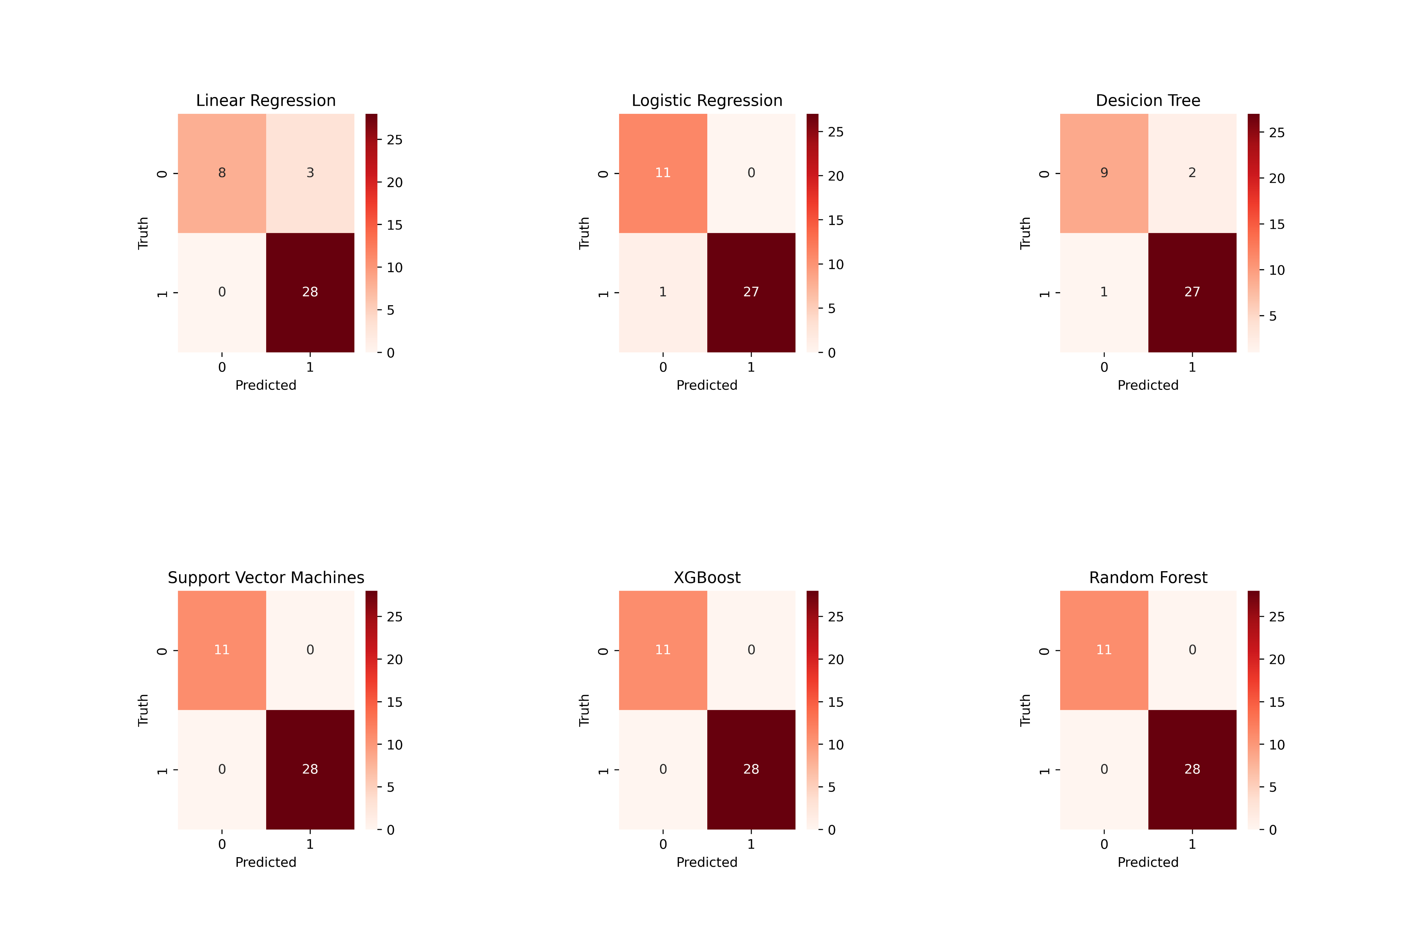
Comparing confusion matrices of all the Classifiers

Slide 23
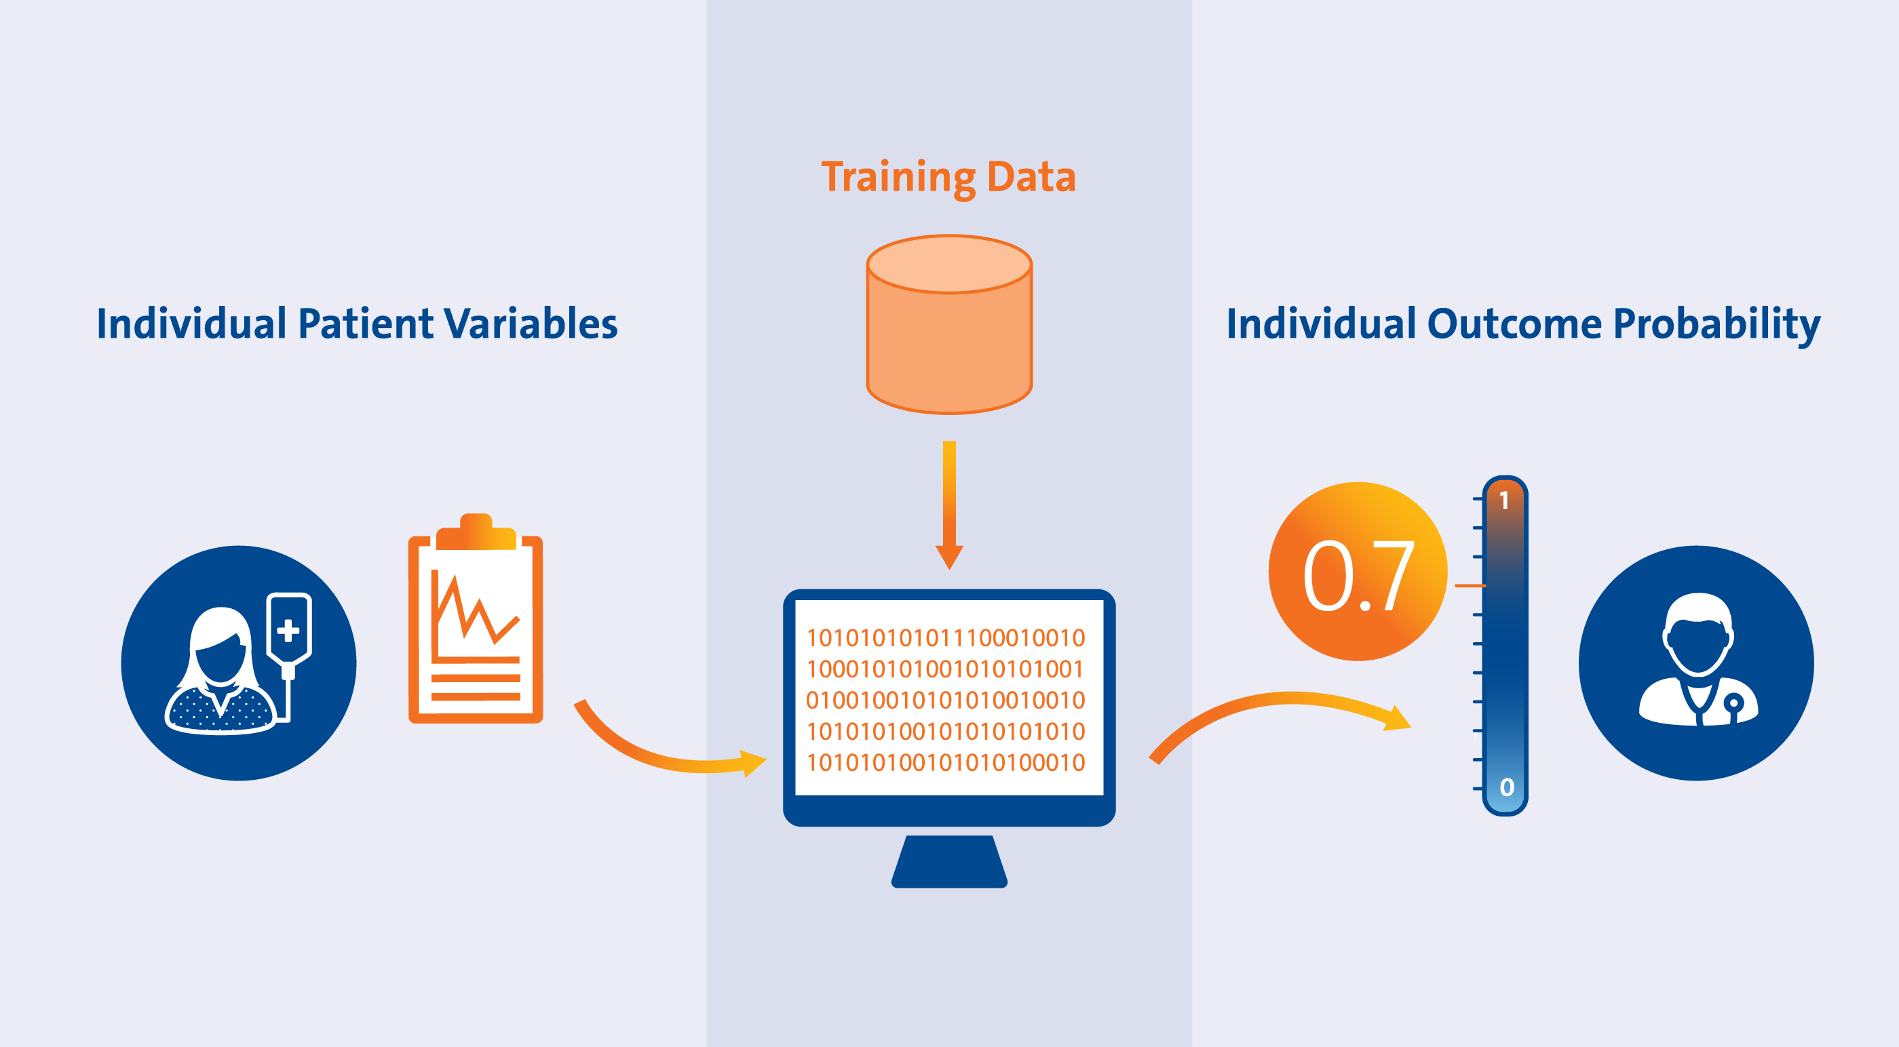
Predictive System:
For detecting Parkinson’s disease for an input, we need to create a predictive system which gives an output whether the person is affected with Parkinson’s Disease or Healthy.
Testing our model by taking some input data, for prediction we also need to check it against some input values given by the user.
Input Data of the person without status from csv
Changing input data to NumPy array
Reshaping the NumPy array
Standardizing the input data
Prediction using Model (Based on cases)
0 -> The patient does not have Parkinson,
1-> The patient has Parkinson

Slide 24
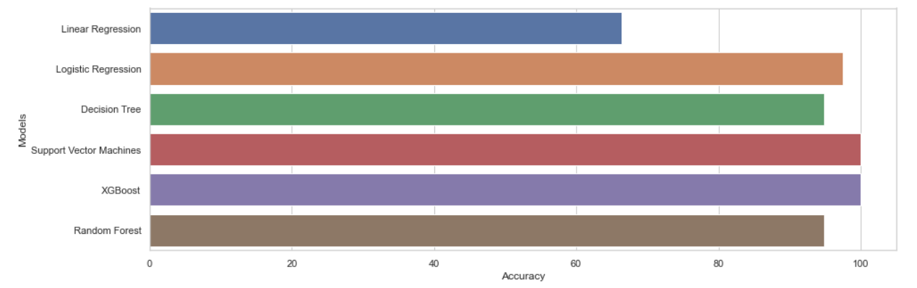
RESULTS
Finally concluding in the result analysis that the opted algorithms under the classification technique show some well-to-do accuracy percentages, especially the Support Vector Machines and XG Boost. Either of these models can be used for predicting the disease. Also, the models Logistic Regression and Random Forest are so close and accurate.

Slide 25
Future Scope and Conclusion
Feature Selection and Dimensionality Reduction algorithms.
Artificial Neural Networks
Open CV
Deep learning techniques

Slide 26

THANK YOU

